Slide 1
Graph Theory
Module-II
Discrete Mathematics
Kailash Kumar
Asst. Prof., CEA
GLAU, Mathura

Slide 2
Introduction
Graphs are data structures consisting of vertices and edges that connect these vertices.
Before going in details first of all we must know the applications of graph

Slide 3
Applications of Graph
to represent who influences whom in an organization
to model acquaintanceships between people
to model roadmaps
to represent the competition of different species in an ecological niche

Slide 4
Applications of Graph
Using graph models, we can determine:
whether it is possible to walk down all the streets in a city without going down a street twice
the number of colors needed to color the regions of a map
whether two computers are connected by a communications link
the shortest path between two cities in a transportation network

Slide 5
Graph
A graph G = (V, E) consists of V, a nonempty set of vertices (or nodes) and E, a set of edges. Each edge has either one or two vertices associated with it, called its endpoints. An edge is said to connect its endpoints.

Slide 6
Graph
The set of vertices V of a graph G may be infinite
A graph with an infinite vertex set is called an infinite graph
A graph with a finite vertex set is called a finite
graph
Here, we consider only finite graphs

Slide 7
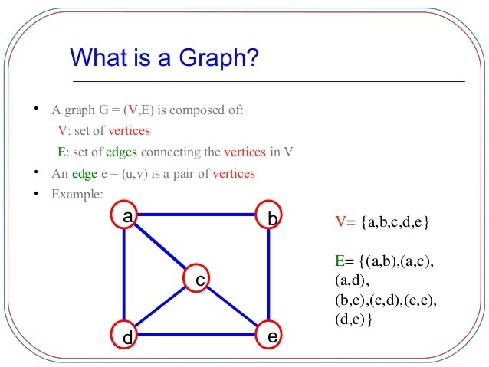
Graph

Slide 8
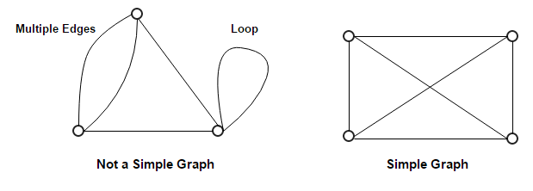
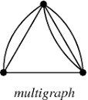
Terminologies
A graph in which each edge connects two different vertices and where no two edges connect the same pair of vertices is called a simple graph.
Multiple edges means more than one edge connecting the same pair of vertices. These are called parallel edges.
Graphs that contains some parallel edges are
called multigraphs.

Slide 9
Terminologies
Edges that connect a vertex to itself are called loops.
Graphs that may include loops and multiple edges are sometimes called pseudographs.

Slide 10
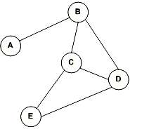
Terminologies
An edge which is associated with an unordered pair of vertices is called an undirected edge
An undirected graph is a graph whose all edges are undirected.
Eg.
(A,B) is same as (B,A)
It is called unordered pair as there is
no direction between vertex A and vertex B

Slide 11
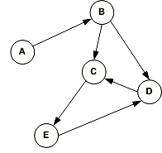
Terminologies
An edge which is associated with an ordered pair of vertices is called a directed edge
A directed graph is a graph whose all edges are directed. Directed graph is also known as digraph.
Edges are directed by arrows.
Eg.
Since there is a direction between
Vertices. Vertices pairs are called ordered
pairs.
(A,B) is an ordered pair
(B,A) does not exist in this graph

Slide 12
Terminologies
Formal Definition
A directed graph (or digraph) (V, E) consists of a nonempty set of vertices V and a set of directed edges (or arcs) E. Each directed edge is associated with an ordered pair of vertices. The directed edge associated with the ordered pair (u, v) is said to start at u and end at v.
When a directed graph has no loops and has no multiple directed edges, it is called as simple directed graph.
Directed graphs that may have multiple directed edges from a vertex to a second (possibly the same) vertex are called directed multigraphs.

Slide 13
Terminologies
When there are m directed edges, each associated to an ordered pair of vertices (u, v), we say that (u, v) is an edge of multiplicity m.
A graph with both directed and undirected edges is called a mixed graph

Slide 14
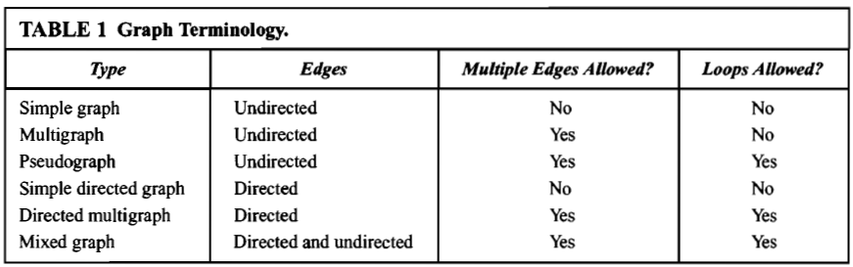
Terminologies

Slide 15
Terminologies
Two vertices u and v in an undirected graph G are called adjacent (or neighbours) in G if u and v are endpoints of an edge of G. If e is associated with {u, v}, the edge e is called incident with the vertices u and v. The edge e is also said to connect u and v. The vertices u and v are called endpoints of an edge associated with {u, v}.

Slide 16
Terminologies
The degree of a vertex in an undirected graph is the number of edges incident with it, except that a loop at a vertex contributes twice to the degree of that vertex. The degree of the vertex v is denoted by deg(v).
A vertex of degree zero is called isolated.
A vertex is pendant if and only if it has degree one.

Slide 17
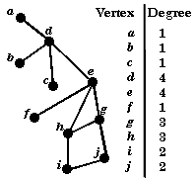
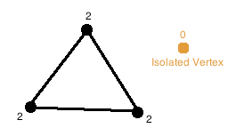

Slide 18
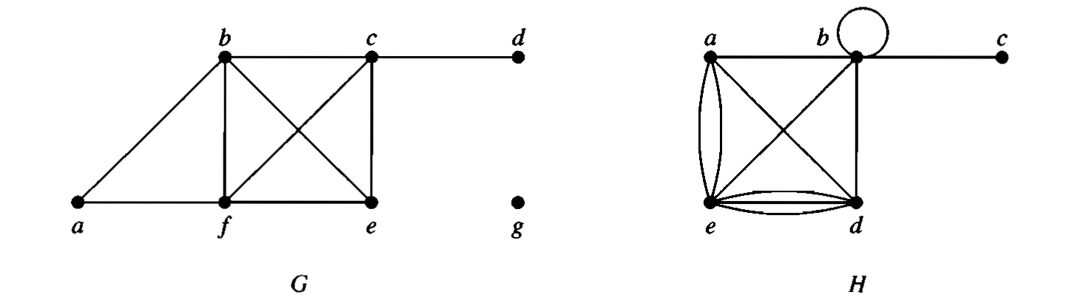
Problem
What are the degrees of the vertices in the graphs G and H ?

Slide 19

THE HANDSHAKING THEOREM
Let G = (V, E) be an undirected graph with e edges. Then
Example
How many edges are there in a graph with 10 vertices each of degree six?
Solution: Because the sum of the degrees of the vertices is 6· lO = 60, it follows that 2e = 60.
Therefore, e = 30.

Slide 20
Terminologies
When (u, v) is an edge of the graph G with directed edges, u is said to be adjacent to v and v is said to be adjacent from u.
The vertex u is called the initial vertex of (u, v), and v is called the terminal or end vertex of (u, v). The initial vertex and terminal vertex of a loop are the same.

Slide 21

Terminologies
In a graph with directed edges
the in-degree of a vertex v, denoted by is the number of edges with v as their terminal vertex.
the out-degree of v, denoted by is the number of edges with v as their initial vertex.
Note that a loop at a vertex contributes 1 to both the in-degree and the out-degree of this vertex.

Slide 22
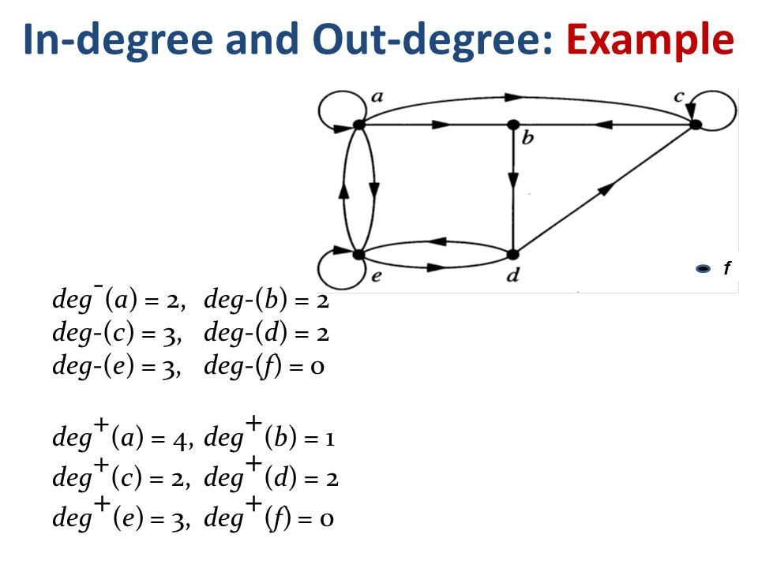

Slide 23
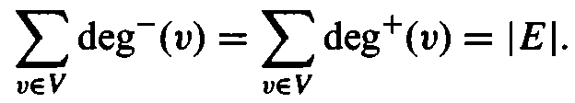
Theorem
Let G = (V, E) be a graph with directed edges. Then
The sum of the in-degrees and the sum of the out-degrees of all vertices in a graph with directed edges are the same. Both of these sums are the number of edges in the directed graph.

Slide 24
Types of Graph
Directed Graph
Complete Graph
Bipartite Graph
Isomorphic Graph
Planar Graph
Euler Graph
Hamiltonian Graph

Slide 25
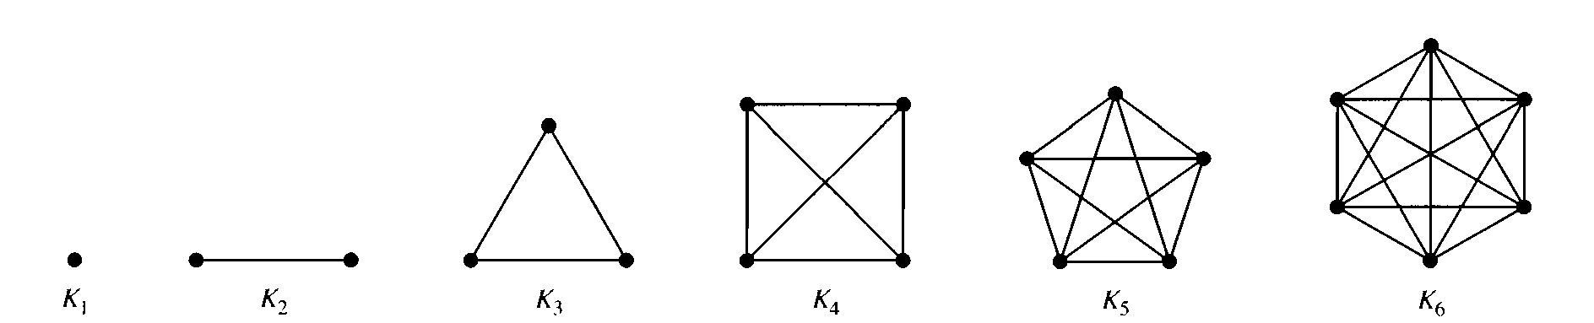
Some Special Simple Graphs
Complete Graphs The complete graph on n vertices, denoted by K_{n} , is the simple graph that contains exactly one edge between each pair of distinct vertices. The graphs K_{n} , for n = 1,2, 3, 4, 5, 6, are as follows:

Slide 26
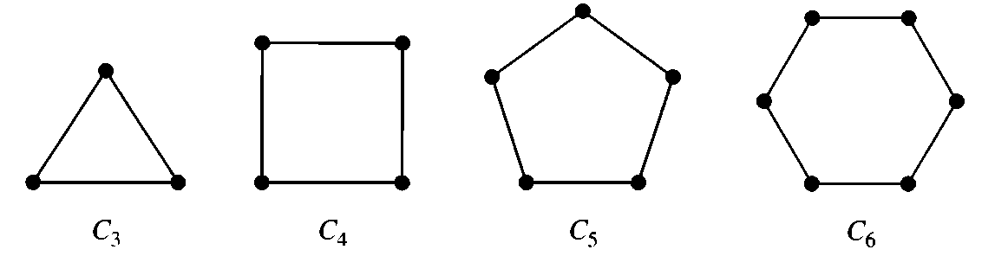
Some Special Simple Graphs
Cycles The cycle C_{n} ; n >= 3, consists of n vertices v1, v2, ..., vn and edges {v1,v2}, {v2,v3}, ... , {vn-1,vn}, and {vn,v1}. The cycles C3, C4 , C5, and C6 are as follows:

Slide 27
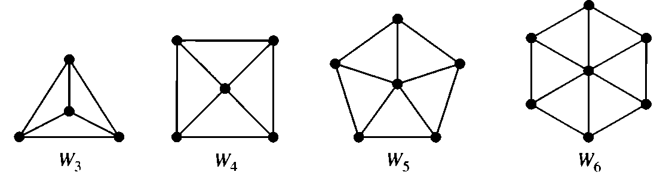
Some Special Simple Graphs
Wheels We obtain the wheel W_{n} when we add an additional vertex to the cycle C_{n} for n >=3, and connect this new vertex to each of the n vertices in C_{n} by new edges. The wheels W₃, W₄, W₅, and W₆ are displayed as follows:

Slide 28
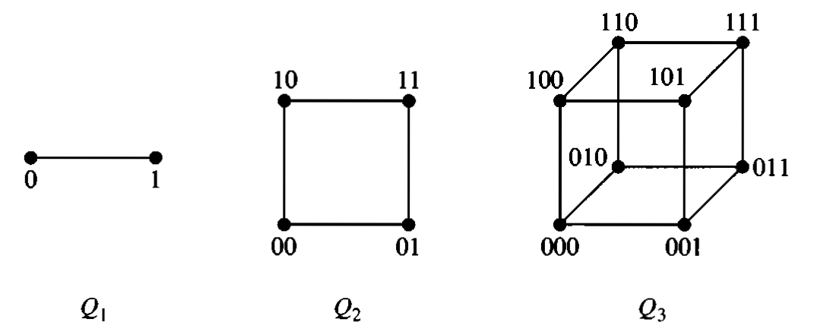
Some Special Simple Graphs
n-Cubes The n-dimensional hypercube or n-cube, denoted by Q_{n} ; is the graph that has vertices representing the 2^{n} bit strings of length n. Two vertices are adjacent if and only if the bit strings that they represent differ in exactly one bit position. The graphs Q1, Q2, and Q3 are displayed as follows:

Slide 29
n-Cubes continued..
We can construct the (n+1)-cube Q_{n+1} from the n-cube Q_{n} by making two copies of Q_{n}, prefacing the labels on the vertices with a 0 in one copy of Q_{n} and with a 1 in the other copy of Q_{n}, and adding edges connecting two vertices that have labels differing only in the first bit.
Q₃ is constructed from Q₂ by drawing two copies of Q₂ as the top and bottom faces of Q₃, adding 0 at the beginning of the label of each vertex in the bottom face and 1 at the beginning of the label of each vertex in the top face.

Slide 30
Some Special Simple Graphs
Regular Graphs The regular graph is the simple graph in which each vertex is of degree k; this is denoted by k-regular graph.
For example, the cycles C_{n} is the 2-regular graphs, as each vertex is of degree 2.
Complete graph K_{n} is (n-1)-regular graphs.

Slide 31
Bipartite Graph
A simple graph G is called bipartite if its vertex set V can be partitioned into two disjoint sets V1 and V2 such that every edge in the graph connects a vertex in V1 and a vertex in V2
No edge in G connects either two vertices in V1 or two vertices in V2
When this condition holds, we call the pair (V1, V2) a bipartition of the vertex set V of G.

Slide 32
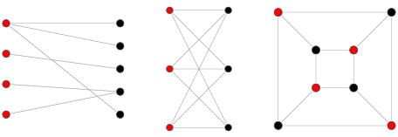
Bipartite Graph
Red vertices are in one set
Black vertices are in another set

Slide 33
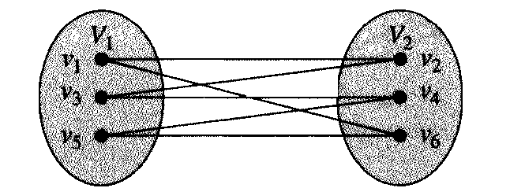
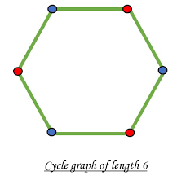
Bipartite Graph
C₆ (cycle graph of length 6) is bipartite, because its vertex set can be partitioned into the two sets V1 = {v1, v3, v5} and V2 = {v2, v4, v6}, and every edge of C₆ connects a vertex in V1 and a vertex in V2.

Slide 34
Theorem
A simple graph is bipartite if and only if it is possible to assign one of two different colors to each vertex of the graph so that no two adjacent vertices are assigned the same color.

Slide 35
Complete Bipartite Graphs
Complete bipartite graph K_{m,n} is the graph that has its vertex set partitioned into two subsets of m and n vertices respectively, such that every vertex of the first set is connected to every vertex of the second set.

Slide 36
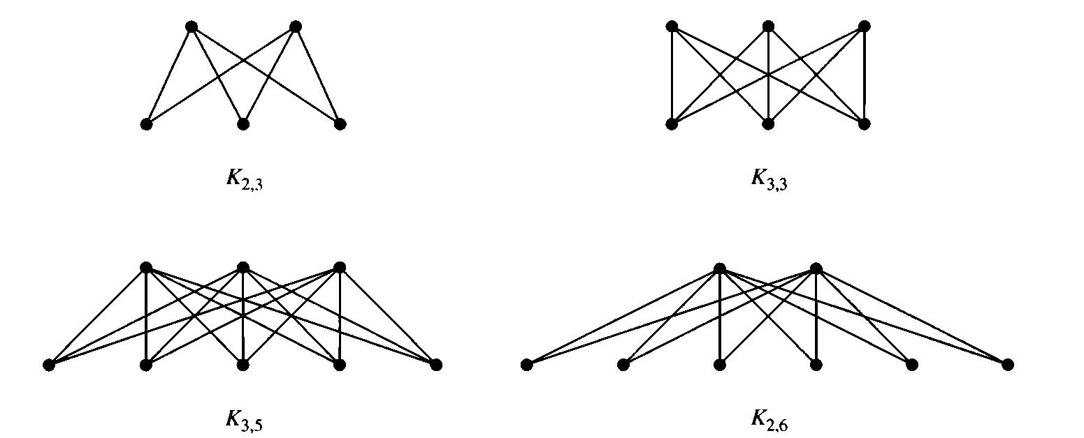
Complete Bipartite Graphs
The complete bipartite graphs K_{2,3} , K_{3,3} , K_{3,5} , and K_{2,6} are as follows:

Slide 37



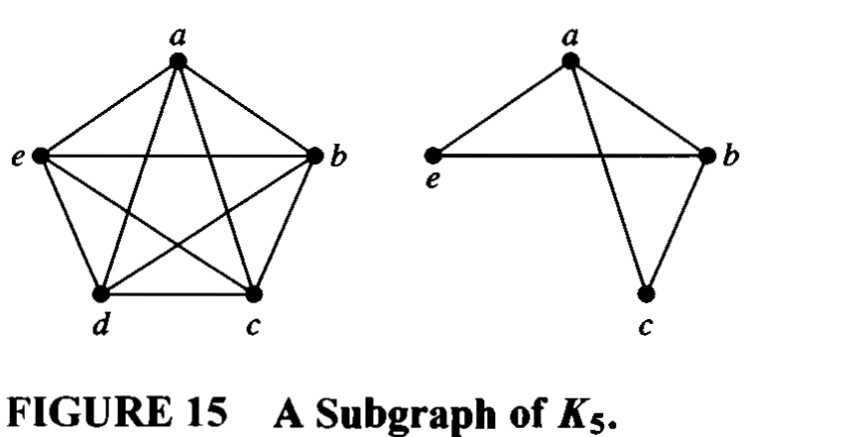
Subgraph
A subgraph of a graph G = (V, E) is a graph
H = (W, F), where and . A subgraph H of G is a proper subgraph of G if
Eg. A subgraph of K5 is as follows:

Slide 38
Operations on graph

Slide 39
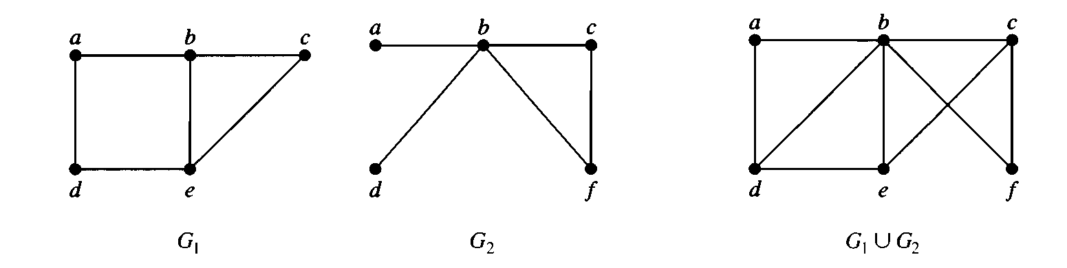
Union of graphs
The union of two simple graphs G1 = (V1, E1) and G2 = (V2, E2) is the simple graph with vertex set V1 U V2 and edge set E1 U E2. The union of G1 and G2 is denoted by G1 U G2.

Slide 40
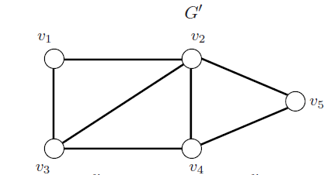
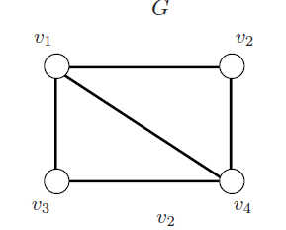
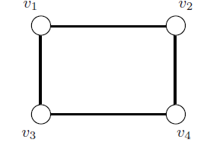
Intersection of Graphs
The intersection of two simple graphs G1 = (V1, E1) and G2 = (V2, E2) is the simple graph with vertex set V1 ∩ V2 and edge set E1 ∩ E2. The intersection of G1 and G2 is denoted by G1 ∩ G2.

Slide 41
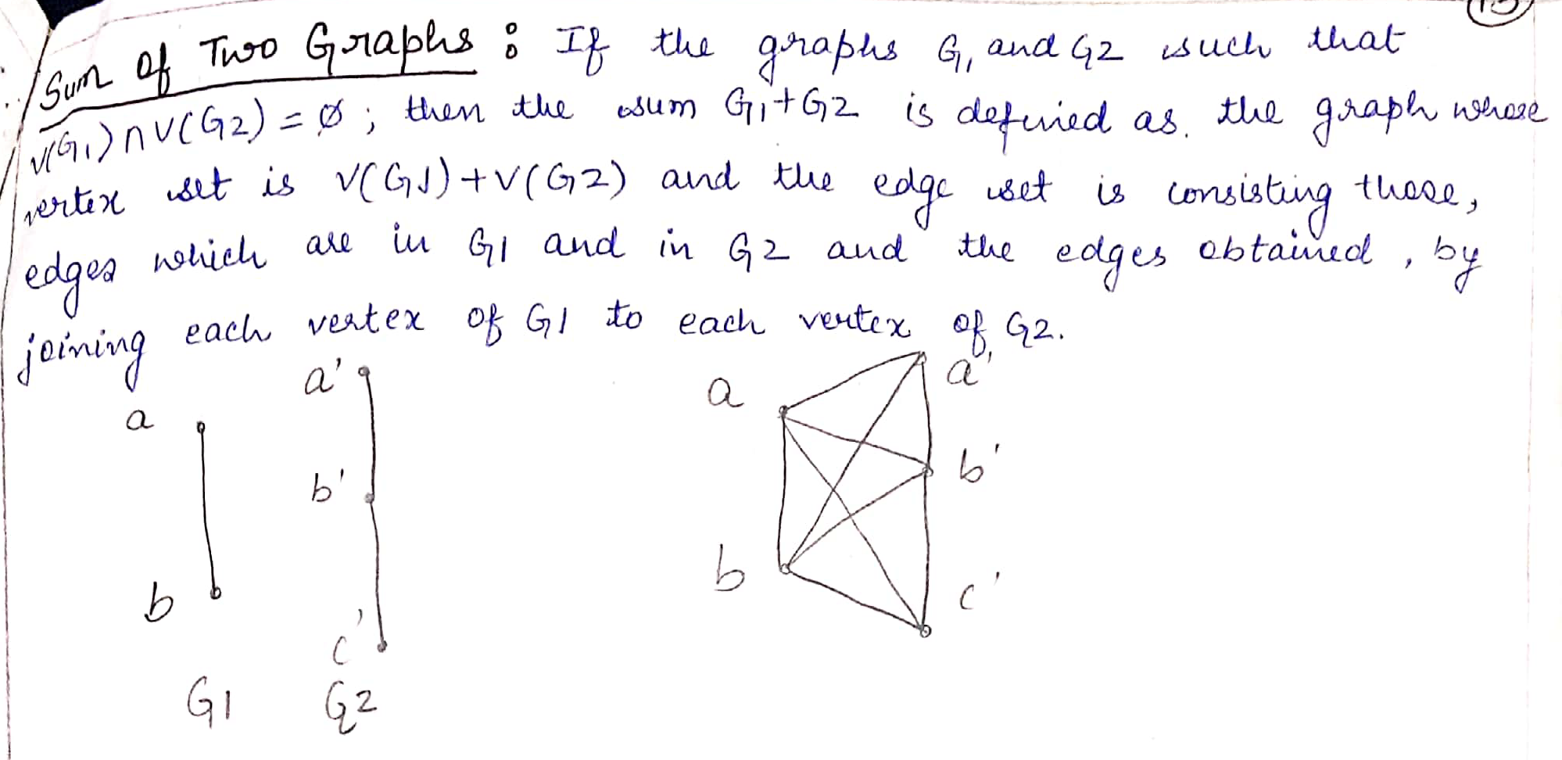
Sum of graphs

Slide 42
Complement
Complement of a simple graph G is a simple graph G’ having-
All the vertices of G.
An edge between two vertices u and v iff there exists no edge between u and v in the original graph G.
The sum of total number of edges in G and G’ is equal to the total number of edges in a complete graph i.e. n(n-1)/2 where n is number of vertices in the graph

Slide 43
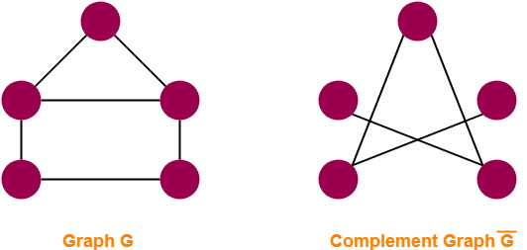
Complement

Slide 44
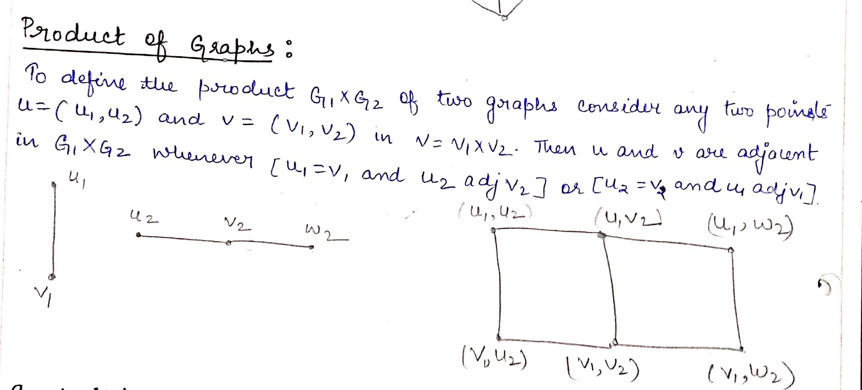
Product of graphs

Slide 45
Isomorphism
The simple graphs G1 = (V1, E1) and G2 = (V2, E2) are isomorphic if there is a one-to-one and onto function f from V1 to V2 with the property that a and b are adjacent in G1 if and only if f(a) and f(b) are adjacent in G2, for all a and b in V1. Such a function f is called an isomorphism.
In other words, when two simple graphs are isomorphic, there is a one-to-one correspondence between vertices of the two graphs that preserves the adjacency relationship.

Slide 46
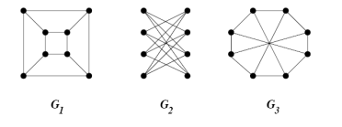
Isomorphism
The number of vertices, the number of edges, and the number of vertices of each degree are all invariants under isomorphism. If any of these quantities differ in two simple graphs, these graphs cannot be isomorphic.

Slide 47
Graph Isomorphism Conditions
For any two graphs to be isomorphic, following 4 conditions must be satisfied-
Number of vertices in both the graphs must be same.
Number of edges in both the graphs must be same.
Degree sequence of both the graphs must be same.
If a cycle of length k is formed by the vertices { v₁ , v₂ , ….. , v_{k} } in one graph, then a cycle of same length k must be formed by the vertices { f(v₁) , f(v₂) , ….. , f(v_{k}) } in the other graph as well.
Degree sequence of a graph is defined as a sequence of the degree of all the vertices in ascending order.

Slide 48
Graph Isomorphism Conditions
The above 4 conditions are just the necessary conditions for any two graphs to be isomorphic.
They are not at all sufficient to prove that the two graphs are isomorphic.
If all the 4 conditions satisfy, even then it can’t be said that the graphs are surely isomorphic.
However, if any condition violates, then it can be said that the graphs are surely not isomorphic.

Slide 49
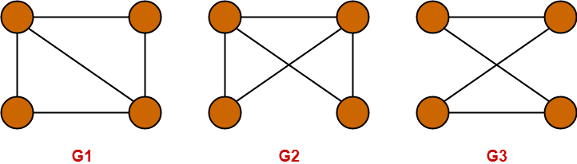
Condition-01:
Number of vertices in graph G1 = 4
Number of vertices in graph G2 = 4
Number of vertices in graph G3 = 4
Condition-02:
Number of edges in graph G1 = 5
Number of edges in graph G2 = 5
Number of edges in graph G3 = 4
∴ G3 is neither isomorphic to G1 nor G2 , as the number of edges are different but G1 may be isomorphic to G2.

Slide 50
Condition-03:
Degree Sequence of graph G1 = { 2 , 2 , 3 , 3 }
Degree Sequence of graph G2 = { 2 , 2 , 3 , 3 }
Here, Both graphs G1 and G2 have same degree sequence.
Condition-04:
Both the graphs contain two cycles each of length 3 formed by the vertices having degrees { 2 , 3 , 3 }
It means both the graphs G1 and G2 have same cycles in them.
Thus, All the 4 necessary conditions are satisfied.
So, graphs G1 and G2 may be isomorphic.

Slide 51
Sufficient Conditions
If any one of these conditions satisfy, then the graphs are surely isomorphic.
Two graphs are isomorphic if and only if their complement graphs are isomorphic.
Two graphs are isomorphic if their adjacency matrices are same.
Two graphs are isomorphic if their corresponding sub-graphs obtained by deleting some vertices of one graph and their corresponding images in the other graph are isomorphic.

Slide 52
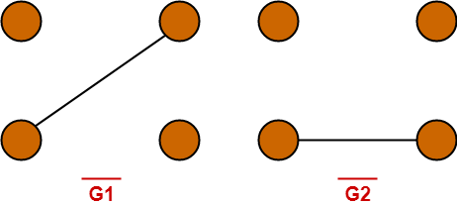
Complement of Graphs G1 and G2 are
Clearly, Complement graphs of G1 and G2 are isomorphic.
∴ Graphs G1 and G2 are isomorphic graphs.

Slide 53
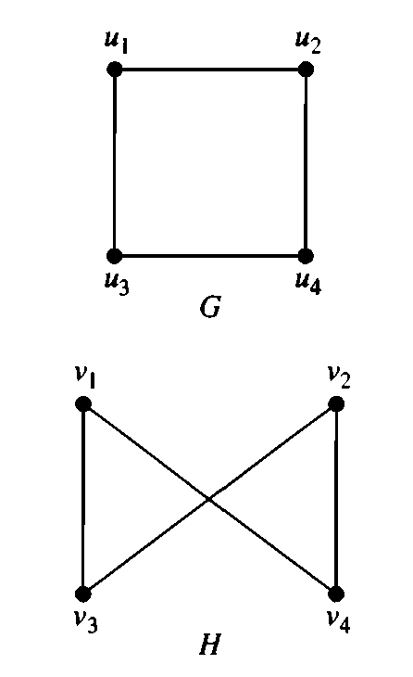
Problem
Show that the graphs G = (V, E) and H = (W, F), displayed in Figure, are isomorphic.
Solution: The function f with f(u1) = v1, f(u2) = v4, f(u3) = v3, and f(u4) = v2 is a one-to-one correspondence between V and W.
To see that this correspondence preserves adjacency, note that adjacent vertices in G are u1 and u2, u1 and u3, u2 and u4, and u3 and u4, and each of the pairs f(u1) = v1 and f(u2) = v4, f(u1) = v1 and f(u3) = v3, f(u2) = v4 and f(u4) = v2, and f(u3) = v3 and f(u4) = v2 are adjacent in H.
Therefore G & H are isomorphic.

Slide 54
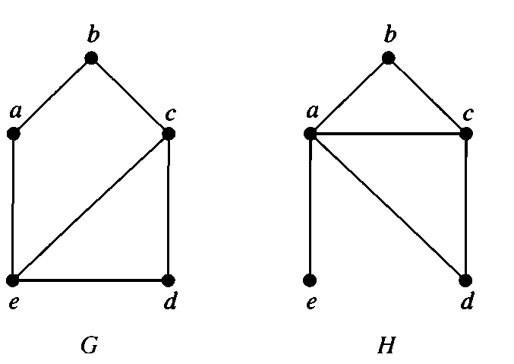
Problem
Show that the graphs shown above are not isomorphic.
Solution: Both G and H have five vertices and six edges. However, H has a vertex of degree one,
namely, e, whereas G has no vertices of degree one. It follows that G and H are not isomorphic .

Slide 55
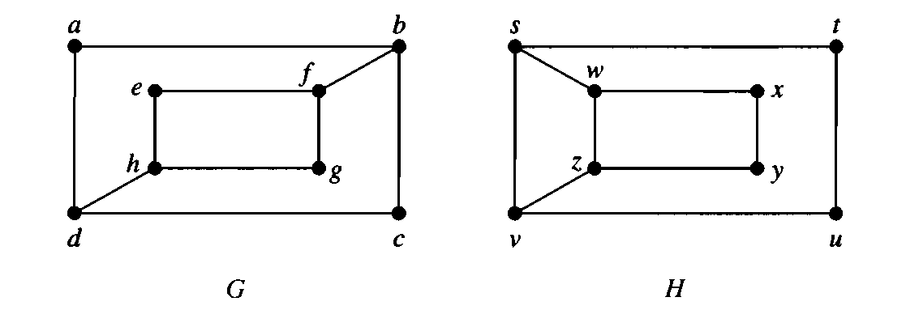
Determine whether the graphs shown above are isomorphic.
Solution: The graphs G and H both have eight vertices and 10 edges. They also both have four vertices of degree two and four of degree three. Because these invariants all agree, however, G and H are not isomorphic.
To see this, note that because deg(a) = 2 in G, a must correspond to either t, u, x, or y in H, because these are the vertices of degree two in H. However, each of these four vertices in H is adjacent to another vertex of degree two in H, which is not true for a in G.

Slide 56
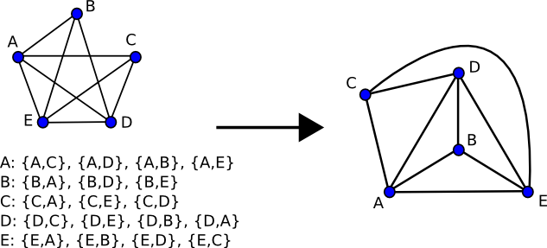
Planar Graphs
A graph is called planar if it can be drawn in the plane without any edges crossing (where a crossing of edges is the intersection of the lines or arcs representing them at a point other than their common endpoint). Such a drawing is called a planar representation of the graph.

Slide 57
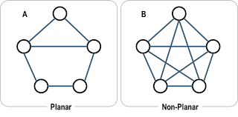
Planar Graphs

Slide 58
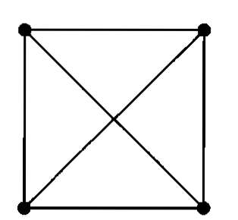
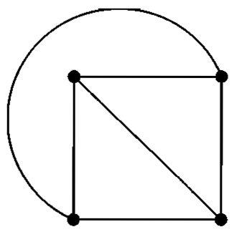
Planar Graphs
A graph may be planar even if it is usually drawn with crossings, because it may be possible to draw it in a different way without crossings.
Is K4 planar?
K4 is planar because it can be
drawn without crossings

Slide 59
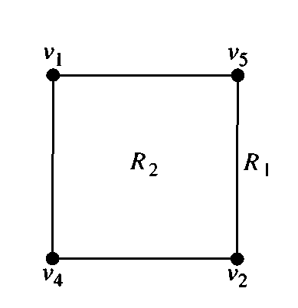
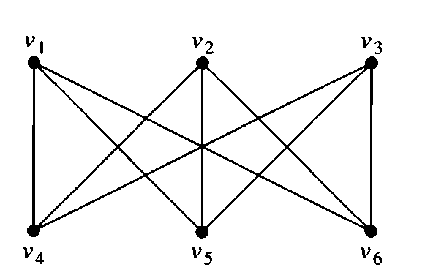
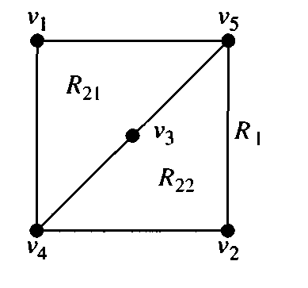
Planar Graphs
Is K_{3,3} planar?

Slide 60
Planar Graphs
Solution: Any attempt to draw K_{3,3} in the plane with no edges crossing is doomed. We now show why.
In any planar representation of K_{3,3} ; the vertices V1 and V2 must be connected to both V4 and V5. These four edges form a closed curve that splits the plane into two regions, R1 and R2.
The vertex V3 is in either R1 or R2. When V3 is in R2, the edges between V3 and V4 and between V3 and V5 separate R2 into two subregions, R21 and R22.

Slide 61
Planar Graphs
Next, note that there is no way to place the final vertex V6 without forcing a crossing.
If V6 is in R1, then the edge between V6 and V3 cannot be drawn without a crossing.
If V6 is in R21 , then the edge between V2 and V6 cannot be drawn without a crossing.
If V6 is in R22, then the edge between V1 and V6 cannot be drawn without a crossing.
Therefore, K_{3,3} is not planar.

Slide 62
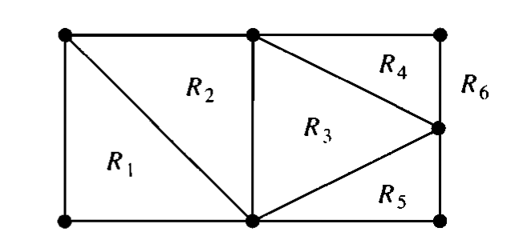
Planar Graphs
A planar representation of a graph splits the plane into regions, including an unbounded region
This is the basis for Euler’s Formula.

Slide 63
EULER'S FORMULA
Let G be a connected planar simple graph with e edges and v vertices. Let r be the number of regions in a planar representation of G.
Then r = e - v + 2

Slide 64
Properties of Planar Graph
In any planar graph, Sum of degrees of all the vertices = 2 x Total number of edges in the graph
In any planar graph, Sum of degrees of all the regions = 2 x Total number of edges in the graph
If G is a planar graph with k components, then
r = e – v + (k + 1)

Slide 65
Example
Suppose that a connected planar simple graph has 20 vertices, each of degree 3. Into how many regions does a representation of this planar graph split the plane?
Solution:
This graph has 20 vertices, each of degree 3, so v = 20. Because the sum of the degrees of the vertices, 3*v = 3*20 = 60, is equal to twice the number of edges, 2e, we have 2e = 60, or e = 30. (by Handshaking Theorem)
Consequently, from Euler's formula, the number of regions is r = e - v + 2 = 30 - 20 + 2 = 12.

Slide 66
Connectivity
A graph is said to be connected if there is a path between every pair of vertex. From every vertex to any other vertex, there should be some path to traverse. That is called the connectivity of a graph. A graph with multiple disconnected vertices and edges is said to be disconnected.

Slide 67
Cut Vertex
Let G be a connected graph. A vertex V ∈ G is called a cut vertex of G, if G-V (Delete V from G) results in a disconnected graph.
Removing a cut vertex from a graph breaks it in to two or more graphs.
Removing a cut vertex may render a graph disconnected.
A connected graph G may have at most (n–2) cut vertices.

Slide 68
Cut Edge (Bridge)
Let G be a connected graph. An edge 'e' ∈ G is called a cut edge if G-{e} results in a disconnected graph.
If removing an edge in a graph results in to two or more graphs, then that edge is called a Cut Edge or Bridge.

Slide 69
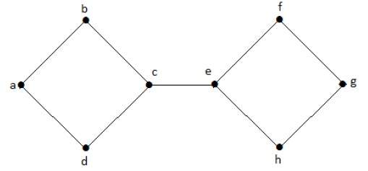
Example
Cut Vertex: c or e
Cut Edge: {c, e}

Slide 70
Properties
Let G be a connected graph with n vertices, then
a cut edge e ∈ G if and only if the edge 'e' is not a part of any cycle in G.
the maximum number of cut edges possible is n-1.
whenever cut edges exist, cut vertices also exist because at least one vertex of a cut edge is a cut vertex.
if a cut vertex exists, then a cut edge may or may not exist.

Slide 71
Cut Set of a Graph
Let G = (V, E) be a connected graph. A subset E' of E is called a cut set of G if deletion of all the edges of E' from G makes G disconnect.
If deleting a certain number of edges from a graph makes it disconnected, then those deleted edges are called the cut set of the graph.

Slide 72
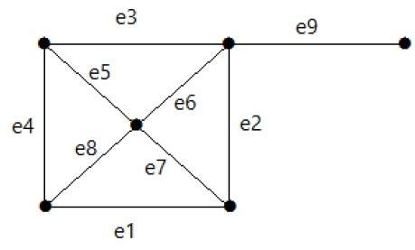
Example
Cut Set:
{e1, e3, e5, e8}
{e1, e3, e6, e7}
{e9}
{e3, e4, e5}
{e1, e2, e7}
{e2, e3, e6}
{e1, e4, e8}

Slide 73
Walk in Graph Theory
A walk is defined as a finite length alternating sequence of vertices and edges.
The total number of edges covered in a walk is called as Length of the Walk.
In graph theory, a walk is called as an Open walk if:
  Length of the walk is greater than zero
  And the vertices at which the walk starts and ends are different.

Slide 74
Walk in Graph Theory
In graph theory, a walk is called as a Closed walk if:
  Length of the walk is greater than zero
  And the vertices at which the walk starts and ends are same.
If length of the walk = 0, then it is called as a Trivial Walk.
Both vertices and edges can repeat in a walk whether it is an open walk or a closed walk.

Slide 75
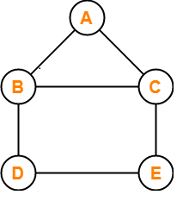
Example
In this graph, few examples of walk are-
A , B , C , E , D
(Length = 4)
D, B, A, C, E, D, E, C
(Length = 7)
E , C , B , A , C , E , D
(Length = 6)

Slide 76
Path in Graph Theory
In graph theory, a path is defined as an open walk in which neither vertices (except possibly the starting and ending vertices) nor edges are allowed to repeat.
In graph theory, a cycle is defined as a closed walk in which neither vertices (except possibly the starting and ending vertices) nor edges are allowed to repeat.
In graph theory, a closed path is called as a cycle.

Slide 77
Path in Graph Theory
In graph theory, a trail is defined as an open walk in which vertices may repeat; but edges are not allowed to repeat.
In graph theory, a circuit is defined as a closed walk in which vertices may repeat; but edges are not allowed to repeat.
In graph theory, a closed trail is called as a circuit.

Slide 78
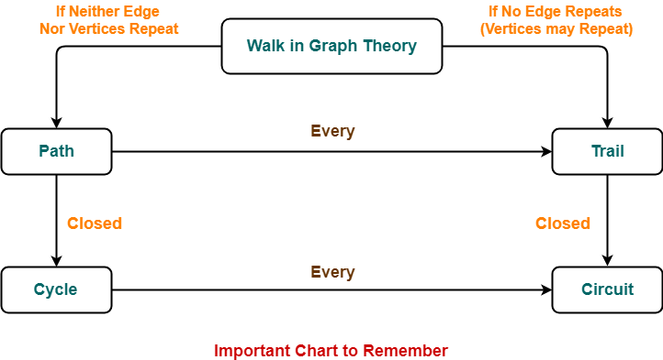
NOTES

Slide 79
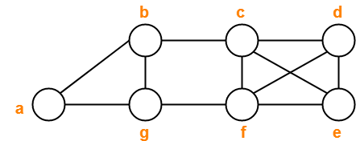
Example-1
Decide which of the following sequences of vertices determine walks.
a , b , g , f , c , b
b , g , f , c , b , g , a
c , e , f , c
c , e , f , c , e
a , b , f , a
f , d , e , c , b
For those that are walks, decide whether it is a circuit, a path, a cycle or a trail.

Slide 80
Solution
a , b , g , f , c , b
b , g , f , c , b , g , a
c , e , f , c
c , e , f , c , e
a , b , f , a
f , d , e , c , b
1. Trail 2. Walk
3. Cycle 4. Walk
5. Not a walk 6. Path

Slide 81
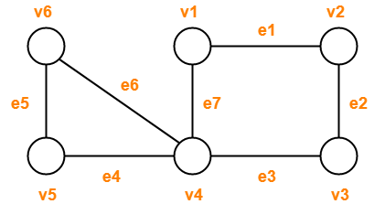
Example-2
v1e1v2e2v3e2v2
v4e7v1e1v2e2v3e3v4e4v5
v1e1v2e2v3e3v4e4v5
v1e1v2e2v3e3v4e7v1
v6e5v5e4v4e3v3e2v2e1v1e7v4e6v6
Observe the given sequences and predict the nature of walk in each case.

Slide 82
Solution
v1e1v2e2v3e2v2
v4e7v1e1v2e2v3e3v4e4v5
v1e1v2e2v3e3v4e4v5
v1e1v2e2v3e3v4e7v1
v6e5v5e4v4e3v3e2v2e1v1e7v4e6v6
Open walk
Trail (Not a path because vertex v4 is repeated)
Path
Cycle
Circuit (Not a cycle because vertex v4 is repeated)

Slide 83
EULER Path
If there exists a walk in the connected graph that visits every edge of the graph exactly once with or without repeating the vertices, then such a walk is called as an Euler walk.
A graph will contain an Euler path if and only if it contains at most two vertices of odd degree.

Slide 84
EULER Circuit
If there exists a walk in the connected graph that starts and ends at the same vertex and visits every edge of the graph exactly once with or without repeating the vertices, then such a walk is called as an Euler circuit.
A graph will contain an Euler circuit if and only if all its vertices are of even degree.

Slide 85
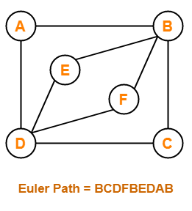
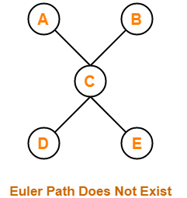
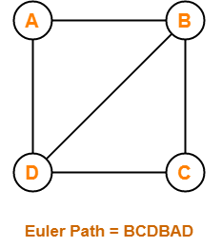
Example
Euler Circuit does not exist
Euler Circuit
ABCDFBEDA
Euler Circuit does not exist

Slide 86





EULER Graph
Any connected graph is called as an Euler Graph if and only if all its vertices are of even degree.
An Euler Graph is a connected graph that contains an Euler Circuit.
Euler Circuit: BACEDCB

Slide 87

Examples
Euler Graph
Not Euler Graph
Euler Circuit: AEDAFDCBA

Slide 88

Examples
Not Euler Graph
Not Euler Graph

Slide 89

Examples
Euler Graph
Not Euler Graph

Slide 90
Hamiltonian Path
If there exists a walk in the connected graph that visits every vertex of the graph exactly once without repeating the edges, then such a walk is called as a Hamiltonian path.
If there exists a PATH in the connected graph that contains all the vertices of the graph, then such a path is called as a Hamiltonian path.
In Hamiltonian path, all the edges may or may not be covered but edges must not repeat.

Slide 91
Hamiltonian Circuit/Cycle
If there exists a walk in the connected graph that visits every vertex of the graph exactly once (except starting vertex) without repeating the edges and returns to the starting vertex, then such a walk is called as a Hamiltonian circuit.
If there exists a CYCLE in the connected graph that contains all the vertices of the graph, then that cycle is called as a Hamiltonian circuit.

Slide 92
Hamiltonian Circuit/Cycle
A Hamiltonian path which starts and ends at the same vertex is called as a Hamiltonian circuit.
A closed Hamiltonian path is called as a Hamiltonian circuit.
Any Hamiltonian circuit can be converted to a Hamiltonian path by removing one of its edges.
Every graph that contains a Hamiltonian circuit also contains a Hamiltonian path but vice versa is not true.
There may exist more than one Hamiltonian paths and Hamiltonian circuits in a graph.

Slide 93



Example
Hamiltonian Circuit
ABCEDA
Hamiltonian Circuit
does not exist
Hamiltonian Circuit
does not exist

Slide 94
Hamiltonian Graph
If there exists a closed walk in the connected graph that visits every vertex of the graph exactly once (except starting vertex) without repeating the edges, then such a graph is called as a Hamiltonian graph.
Any connected graph that contains a Hamiltonian circuit is called as a Hamiltonian Graph.

Slide 95
Examples
No Hamiltonian Path
No Hamiltonian Circuit
No Hamiltonian Path
No Hamiltonian Circuit

Slide 96
Examples
Hamiltonian Path:
ABCDHGFE
Hamiltonian Circuit:
ABCDHGFEA
Hamiltonian Path:
ABCDEFG
Hamiltonian Circuit:
ABCDEFGA

Slide 97
Examples
Hamiltonian Path:
ABCDEFGHI
Hamiltonian Circuit:
ABCDEFGHIA
No Hamiltonian Path
No Hamiltonian Circuit

